Slide 1

MARKETING & RETAIL ANALYSIS
MRA
SALES DATA
MILESTONE1 – SIVANI VARMA

Slide 2

Agenda -
Agenda of this project is to find the underlying buying patterns of the customers of an automobile part manufacturer. based on the past 3 years of the Company's transaction data and recommend them customized marketing strategies for different segments of customers.
Executive Summary of the data-
We have received the 3 years data of automobile part manufacture. Consisting 2747 entries with 20 variable details regarding the demography of the product and customer information.

Slide 3

Contents
Problem Statement
Data Summary
EDA
Customer Segmentation using RFM Analysis
KNIME Workflow Image
RFM Analysis Output
Inferences
Recommendation
WorkBooks

Slide 4
PROBLEM STATEMENT:
An automobile parts manufacturing company has collected data of transactions for 3 years. They do not have any in-house data science team, thus they have hired you as their consultant. Your job is to use your magical data science skills to provide them with suitable insights about their data and their customers.
Auto Sales Data: Sales_Data.xlsx
ORDERNUMBER : | Order Number | CUSTOMERNAME : | customer
QUANTITYORDERED : | Quantity ordered | PHONE : | Phone of the customer
PRICEEACH : | Price of Each item | ADDRESSLINE1 : | Address of customer
ORDERLINENUMBER : | order line | CITY : | City of customer
SALES : | Sales amount | POSTALCODE : | Postal Code of customer
ORDERDATE : | Order Date | COUNTRY : | Country customer
DAYS_SINCE_LASTORDER : | Days_ Since_Lastorder | CONTACTLASTNAME : | Contact person customer
STATUS : | Status of order like Shipped or not | CONTACTFIRSTNAME : | Contact person customer
PRODUCTLINE : | Product line – CATEGORY | DEALSIZE : | Size of the deal based on Quantity and Item Price
MSRP : | Manufacturer's Suggested Retail Price
PRODUCTCODE : | Code of Product

Slide 5
Data Summary
The data is about an automobile parts manufacturing company. They have provided the data collected of transactions for 3 years.
The data has 2747 entries (0 To 2746) of rows and 20 columns. The data has 1 datetime64 , 2 foat64, 5 int64,and 12 Object data types.
The dataset has both no null values and no duplicate rows of data.
This data more or less reflects the purchasing behavior of customers in different categories . The company is into automobile part manufacture, and they have different product line like Classic car , Motorcycle, plane, train, ship, Bus truck, vintage cars etc.
There is presence of outliers in variables such as Quantity ordered, Price and Sales.
Variable ‘Sales’ has highest positive skewness(0.784) and Variable ‘Days_since_lastorder’ has lowest negative skewness(-0.002).
The data maintained each transactions entry as order number and for each order number maintained all required information like customer identity details , and product details like price , quantity , product code, and sales for each customer.
We noticed that one order number has many different entries with different product codes.
Manufacturer's Suggested Retail Price(MSRP) for each product code is decided but we found that this is not matching with Price of Each item & is inconsistent with MSRP.

Slide 6
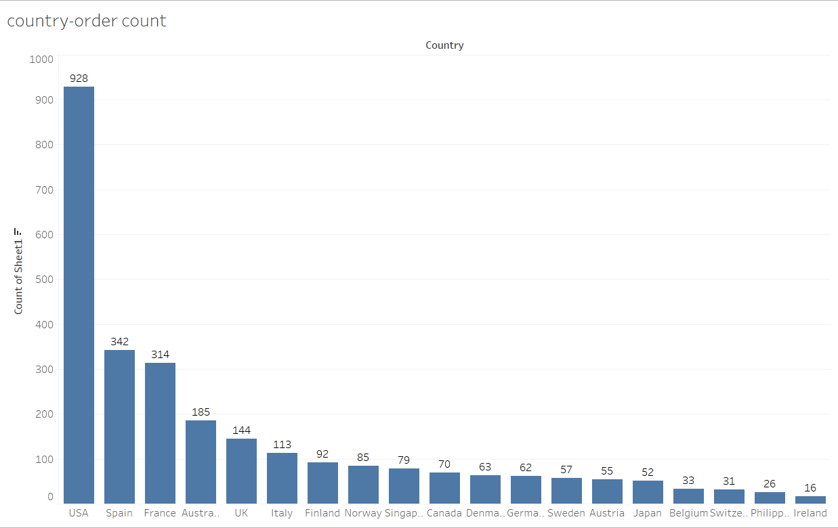
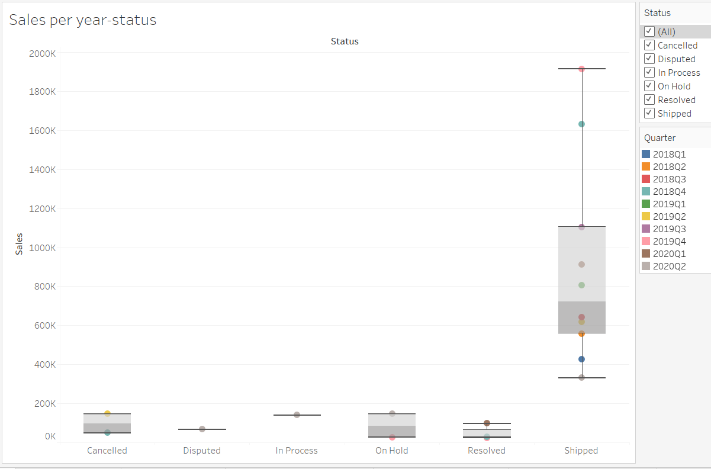
EXPLORATORY DATA ANALYSIS-
Univariate, Bivariate, and multivariate analysis using data visualization
Using boxplot on sales & status variable we have plotted univariate analysis. We can clearly see that outlier is present there. Also using histogram on sales variable we did univariate analysis. For Categorical variable like product line we also did univariate analysis using bar plot.

Slide 7
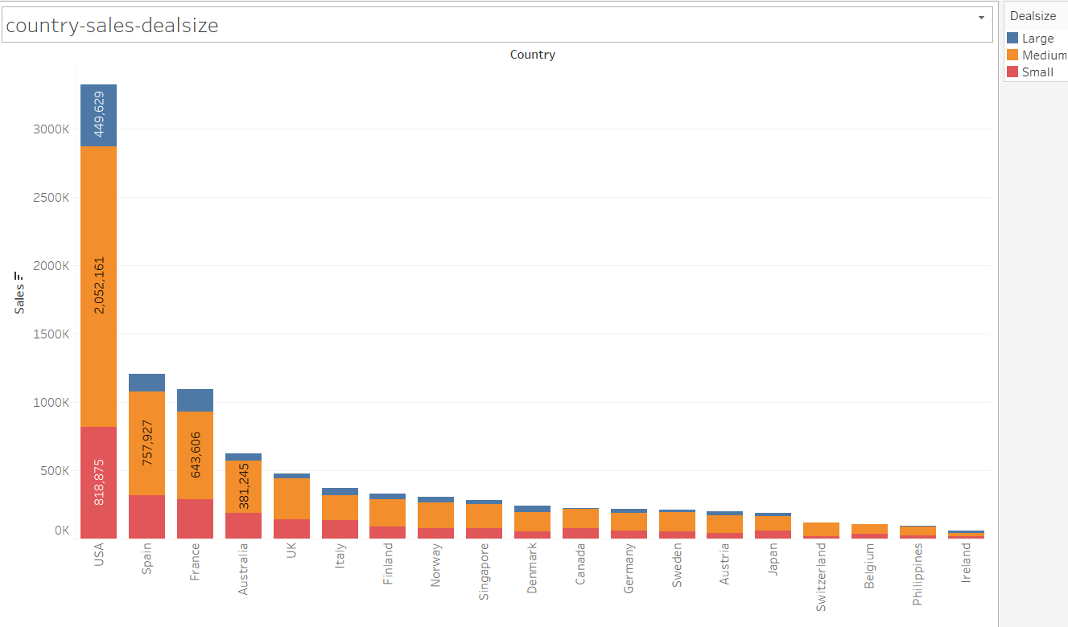
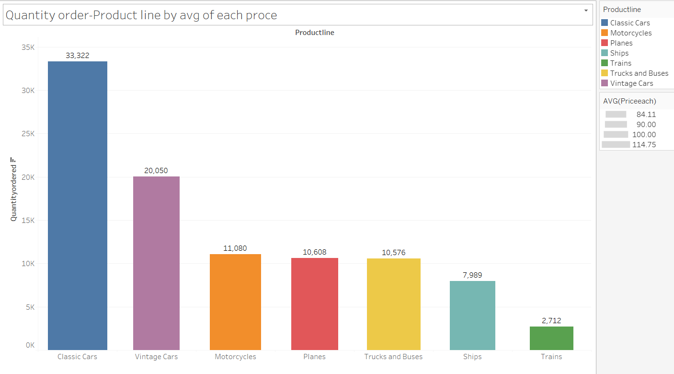
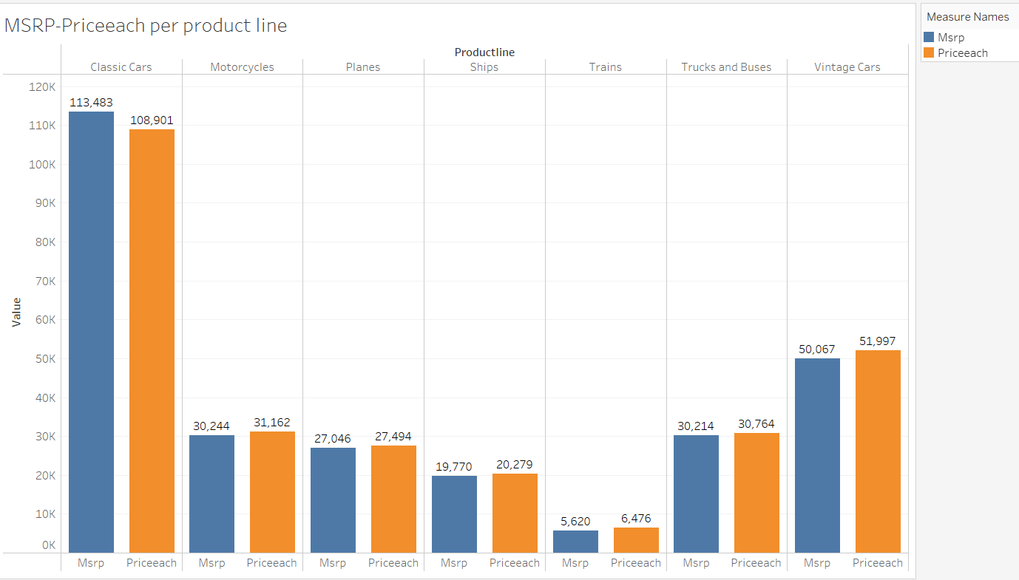
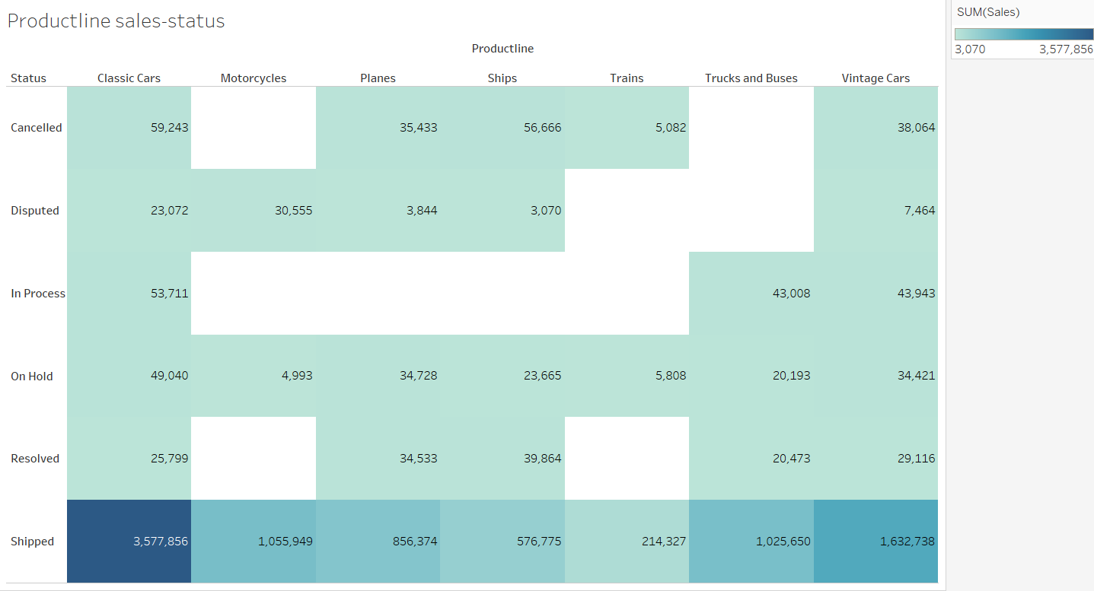
Analysis on Sales, Country, Deal Size, Quantity order, Product line and MSRP
Sales are high for classic cars, the company has even sold below MSRP, there might be a chances that the company has given more discounts to its customers. And vice versa for vintage cars were the company has sold above MSR.

Slide 8
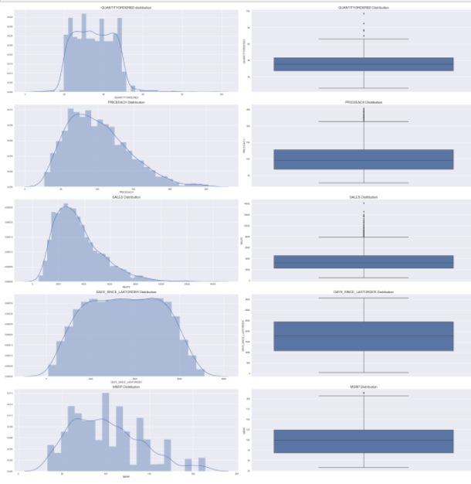
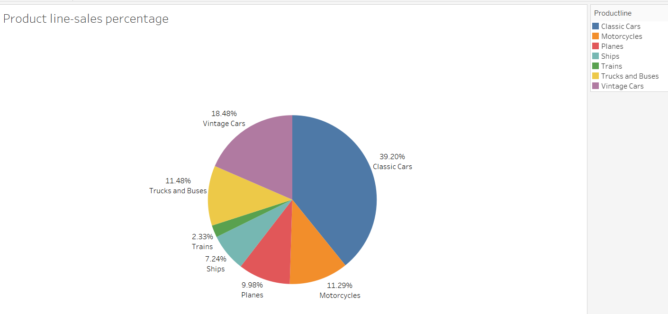
Distplot and Boxplot
There is presence of outliers in variables such as Quantity ordered, Price and Sales.
Variable ‘Sales’ has highest positive skewness(0.784) and Variable ‘Days_since_lastorder’ has lowest negative skewness(-0.002)
Using boxplot on sales & product line variables we have plotted bivariate analysis. We can clearly see that outlier is present in each product line category .Using boxplot on sales & deal size variables we have plotted bivariate analysis. We can clearly see that outlier is present in Large deal size. In Pie chart we can see the larger portion of classic cars followed by vintage cars were as trains has the least demand.

Slide 9
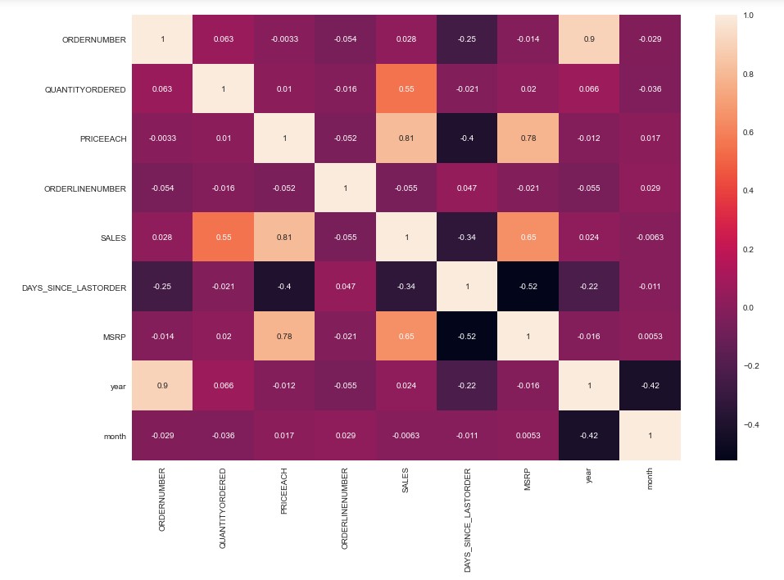
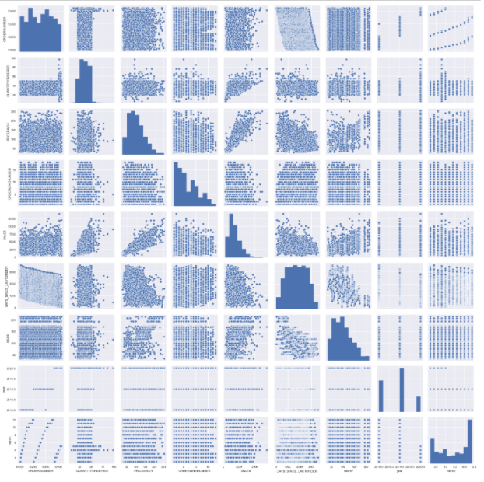
Multi Variate Analysis
Variables ‘Sales’ and ‘Price each’ have highest positive Correlation(0.81) and Variables ‘Days_since_lastorder’ and ‘MSRP’ have highest negative Correlation(-0.52)
From the plot , we can see that none of the variables are symmetric.
Variables ‘Sales’ and ‘Price each’ have almost linear relation ship between them.
From the plots , we can see there is higher spread of data along the trend line for MSRP compared to Price each. So we need to maximize sales by identifying respective items for which there is higher price change.

Slide 10
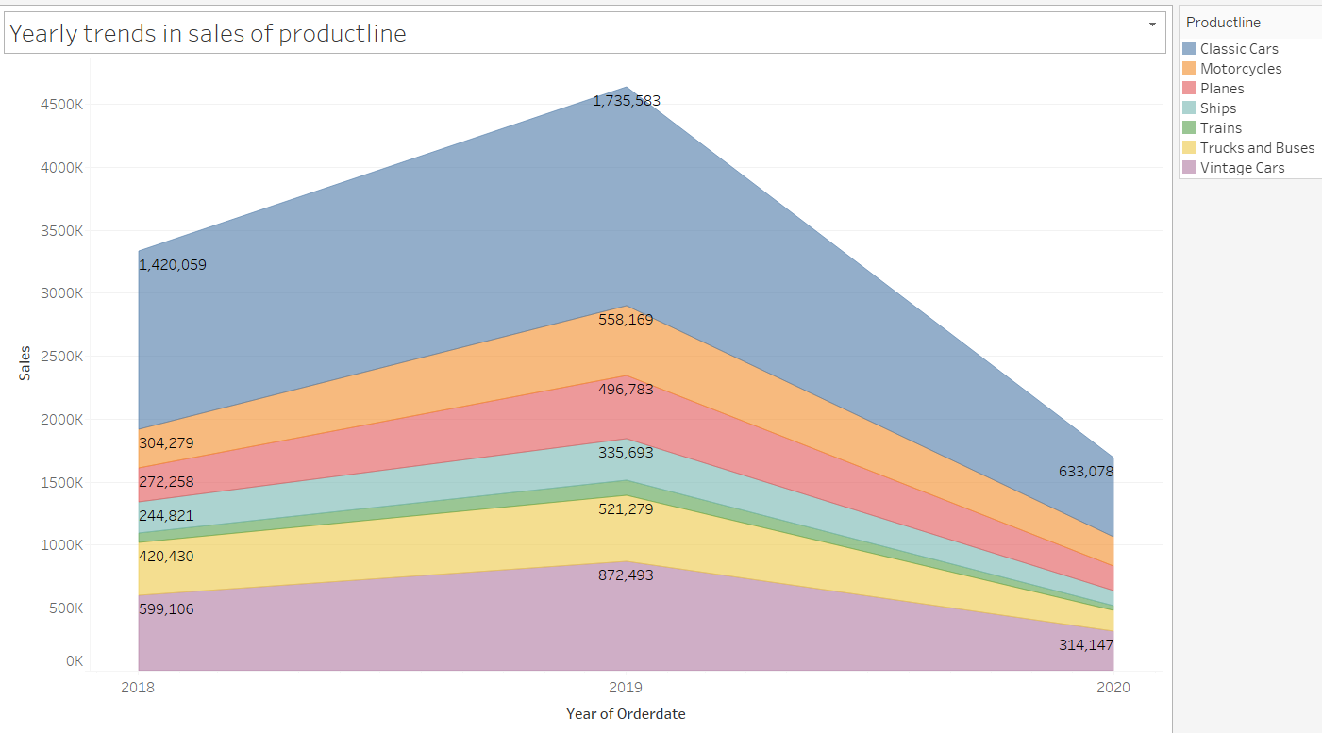
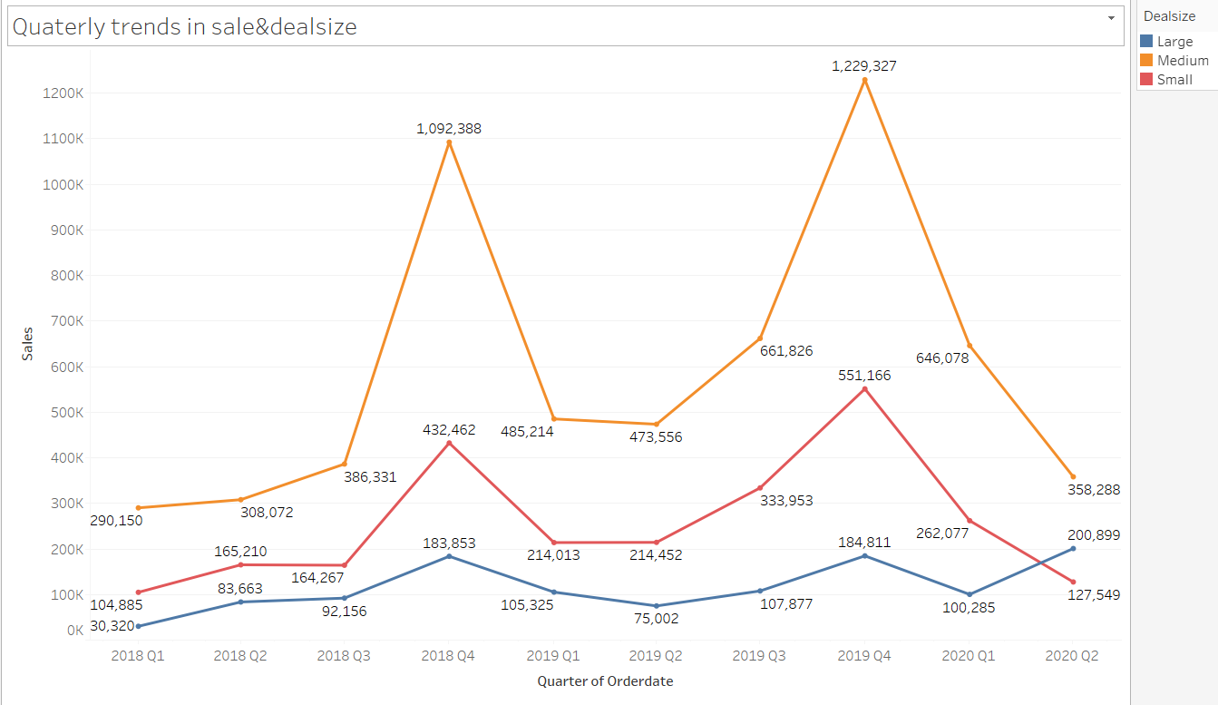
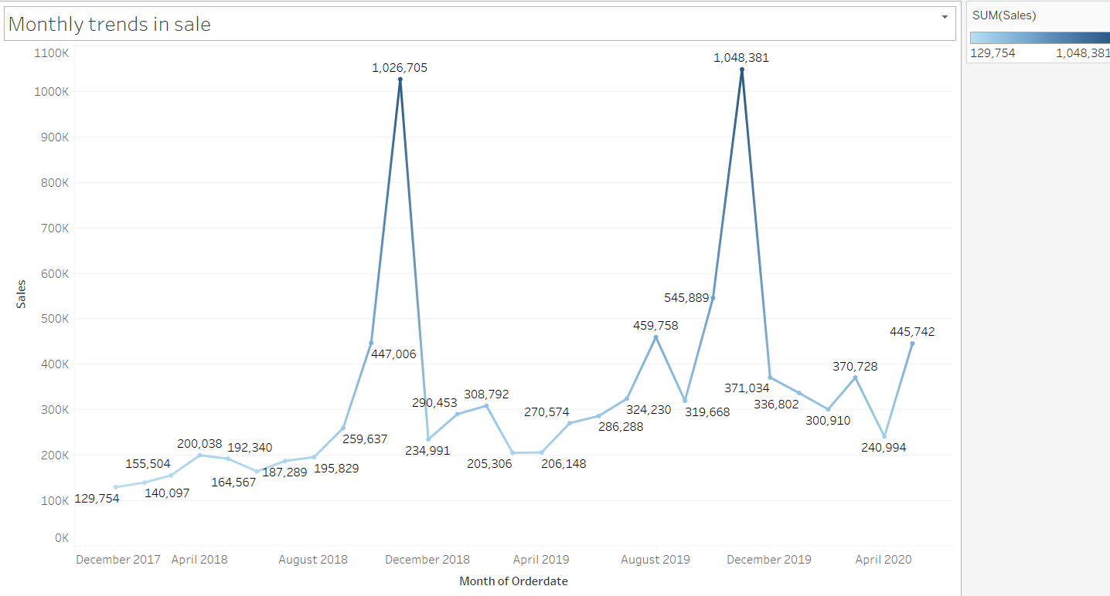
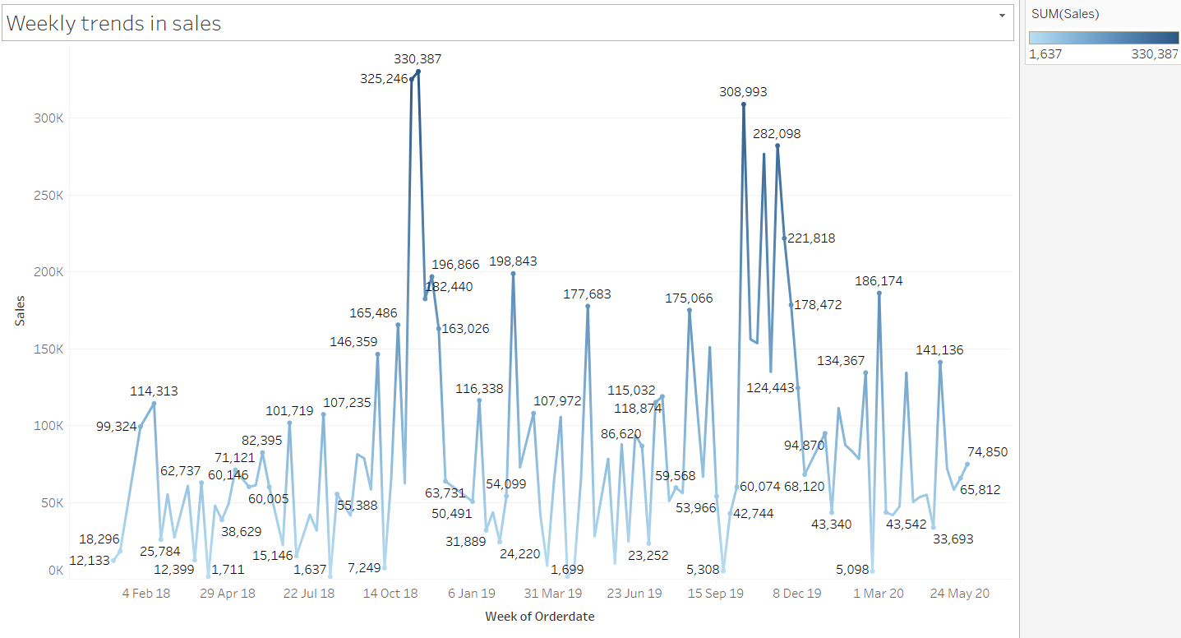
Weekly, Monthly, Quarterly, Yearly Trends in Sales
Yearly, Quarterly, monthly, Weekly time series analysis & its trend are been shown. We observed that in Last quarter sales are high as compared to other quarters. There is a seasonality seen.

Slide 11
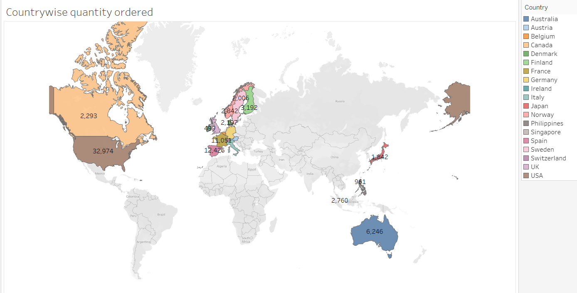
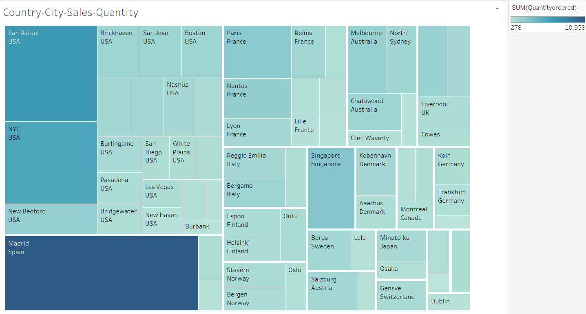
Country Wise Quantity ordered
USA has the highest count of customers(32) and Ireland has the least count of customers(1).
Also USA has the highest quantity ordered, in which San Rafael, NYC holds the highest record.

Slide 12
Inferences
Using histogram on sales variable, we did univariate analysis.
For categorical variable like product line we did univariate analysis using bar plot.
Using boxplot on sales, product line, deal size variable we have plotted bivariate analysis.
Using MSRP, Price each, status, sales & product line variables we did multivariate analysis.
After doing the analysis, we can see there is a high demand of classis cars followed by vintage cars and the least is for trains.
The sales are high for the last Quarter of the year.
The demand for classic cars are so high that the company have sold the product below MSRP giving the customers a good discount.
And Vintage were sold above MSRP.

Slide 13
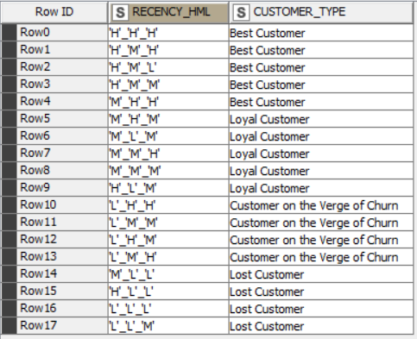
Customer Segmentation using RFM analysis
Customer Segmentation done by using KNIME and MS Excel by dividing the data based on Recency, Frequency and Monetary variables through grouping data by variable ‘Order Number’.
As per the suggestion about ignoring the column "Days Since last order" .
created new column name Recency as "[Max(order date) - order date)]"We have assumed “30-05-2020“ as a reference date and created recency column.
If we can see the data there are same order number repeated for different product Code. So we can assume count of each order number as frequency of an order number.
In SALES column we get sales amount for each transaction. We can use SALES parameter and using an assumption of sum of aggregation we created a new column as Monetary
Then created four different bin for each Recency, frequency & Monetary using percentile range(0,0.10, 0.70,100).Based on above 4 bin assumption we have considered 4 segments like Loyal , Best , Lost and the customers on the verge of Churn.

Slide 14
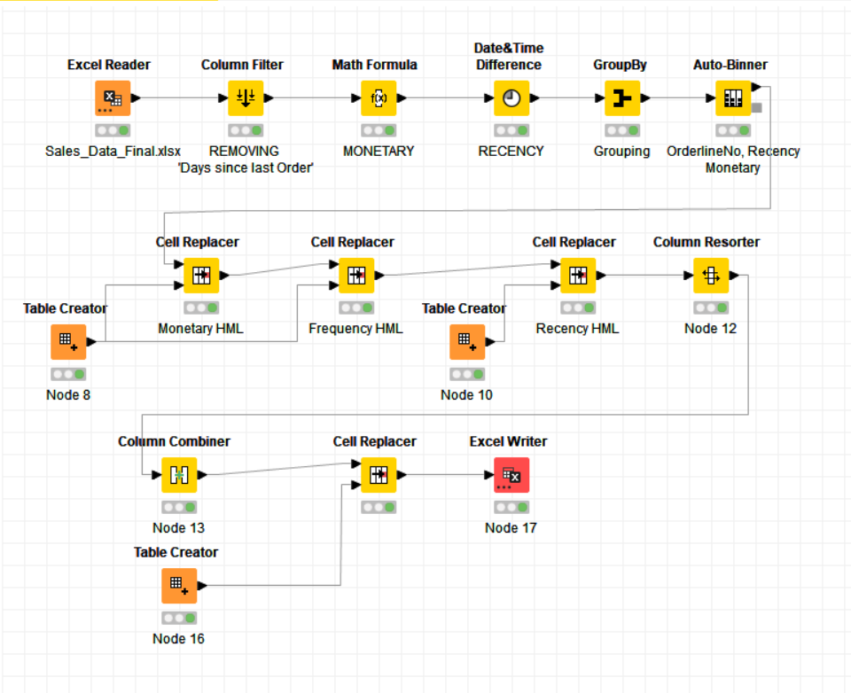
KNIME WORKFLOW and Output table Image-

Slide 15
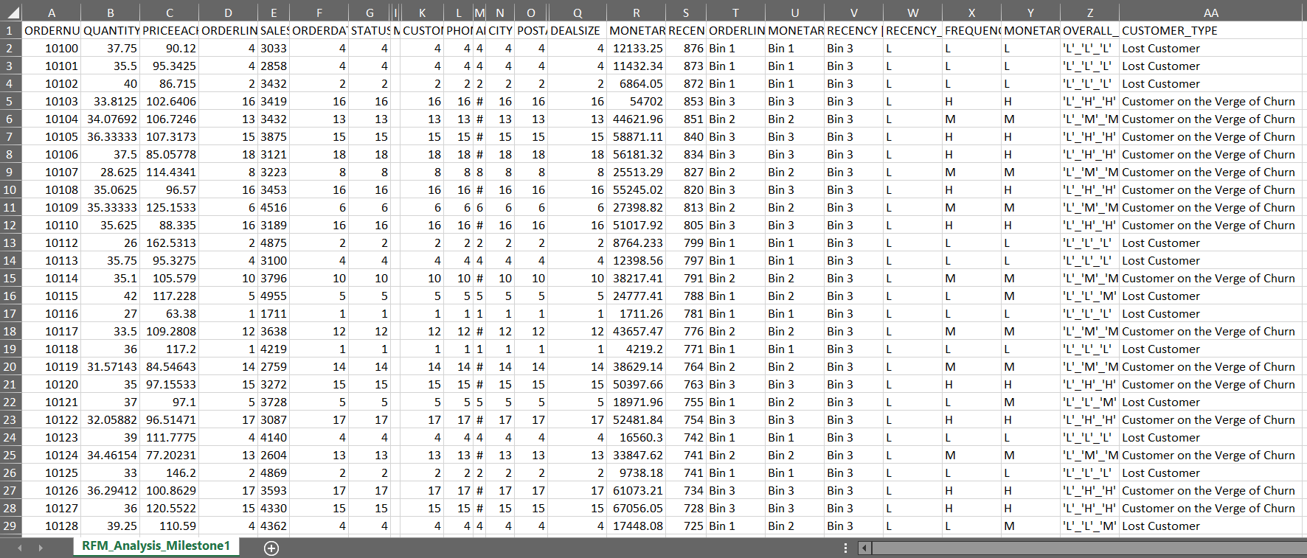
KNIME WORKFLOW and Output table Image-

Slide 16
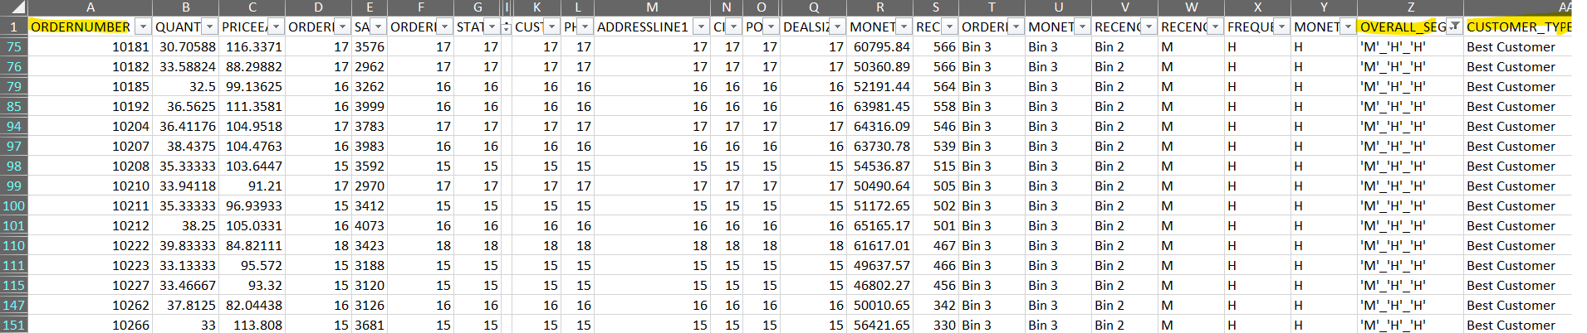
Inferences from RFM Analysis and identified segments
BEST CUSTOMER:
On basis on Recency, frequency & monetary we have grouped our top customers.
We have given the most significance to recency parameter as these customers has recently purchased our products.
Also according to RFM model the most important is given to recency. Hence we have kept it as our first parameter for selecting top customers for e.g. Customer number -10181,10182, 10185
We should not loose these customers at any cost as they are the biggest contributors of the business.

Slide 17
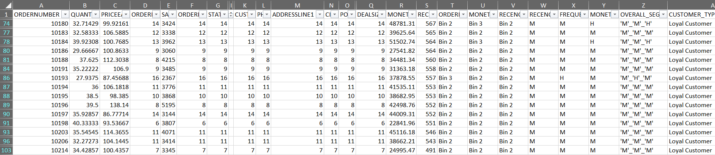
Inferences from RFM Analysis and identified segments
LOYAL CUSTOMER:
On basis on Recency, frequency & monetary we have grouped our loyal customer's. These customers have purchased multiple times with good monetary value.
If we focus more on this segment of customers, we can easily turn them into our top best customers too. Also, in this segment we can see the customers for product line - classic cars are many.
These are the still valuable customers as they are with better level in all aspects Frequency and Monetary. We have to look after the needs of these customers to bring them into the pool of best.

Slide 18
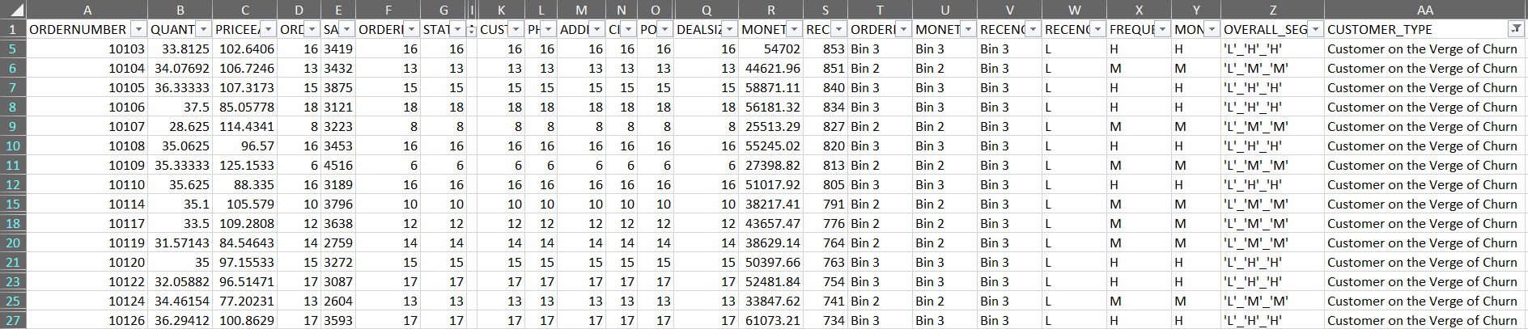
Inferences from RFM Analysis and identified segments
CUSTOMERS ON THE VERGE OF CHURN:
On basis on Recency, frequency & monetary we have grouped our Customers who are on verge of churning. We should definitely focus on this group before we lose them and try to convert them into our regular customers.
For e.g. 10103, 10104– Their frequency is good with good monetary value, but low recency made them stand in this group. If the company pays more attention and fulfill their requirement, then we can easily turn them into our regular customer and we can save them from churning out.
We can still concentrate on them to increase business as they have got High Recency level.

Slide 19
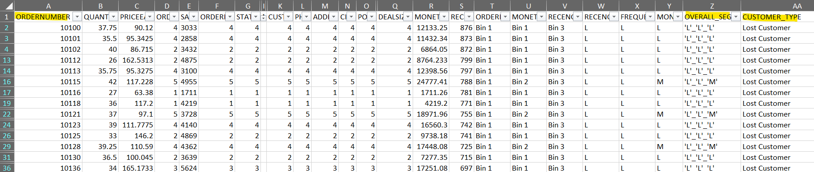
Inferences from RFM Analysis and identified segments
LOST CUSTOMERS :
On basis on Recency, frequency & monetary parameters we have grouped our Customers who we’d lost
Their recency is very low and hasn’t made any purchase since long. So we can say these are our lost customers. If taken feedback from them and fulfill their demand we might bring them back to been a good customer.
But suggestion is to not to invest much time on these type of customers.
As these are the most avoidable customers as they are with lowest level in all aspects Recency, Frequency and Monetary. There is no point in spending time and effort to maintain business with these customers.

Slide 20
RECOMMENDATION:
Using Recency, frequency & monetary parameters we have grouped our Top , loyal, on the verge of churning and lose customers. Customers with good recency has been our top customers were as we also have lost customer lists.
Customers on verge of churning can be saved and can be converted into a good buyer.
RFM model is used for deriving the customers types like Loyal, top or best, on verge of churning & lost customers.
Recency, frequency & monetary parameters were widely used to bifurcate the types of customer's.
This model can be very helpful to the company to maintain its sales and customers and can focus on how the company has lost the customers & can take various actions to bring them back.
It is vital for the company to convert the customers who are on verge of churning into a regular customer or at least maintain them.
And also how to increase the sales ratio can be identified.

Slide 21

Jupyter Notebook- Attaching the code book - MRA Project - Milestone 1_Sivani_Varma.ipynb Tableau Workbook- https://public.tableau.com/app/profile/sivani.varma/viz/MRAProject-Milestone1_16272298537980/country-ordercount?publish=yes KNIME Workbook- Attaching with the PPT Submission along with the output excel file- RFM_Analysis_Milestone1.xlxs

Slide 22
THANK YOU
MRA
SALES DATA
SIVANI VARMA

